Slide 1

Timesketch_importer : support psort filters
Team ID: 17
Members: 2021111945 2021112845 2021112810 2021110669
2021112808 2021113278 2021111928 2021111933

Slide 2
MENU
MENU
01
A brief description of the project
02
Details
03
Lessons we receive from the project

Slide 3
01
A brief description of the project

Slide 4
Three issues we initially choose
1. Support psort filters when ingesting into Timesketch
2. Deploy script should start containers
3. Keyboard shortcuts for timeline navigation

Slide 5
How we choose these issues
The main factors we consider in our selection are the importance, feasibility and difficulty of the issue.
We make full use of labels to help our choices to filter out some of the less important or not feasible issues.
Then we click on the link and analyze it.

Slide 6
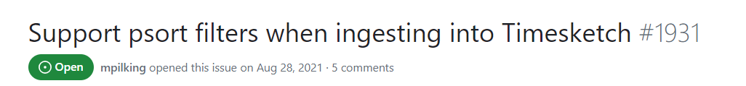
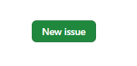
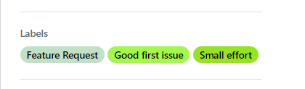
The issue that we need to work on

Slide 7
description of the problem
Some hosts produce very large plaso data sets.
Also, the majority of parsed events from the DC are Windows event logs. Most of the time we only care about the Creation Time events.
The author of the issue have a psort filter he can use that will output just the Windows event log Creation events and also filter to a time range of interest.
However, he doesn't know of a way to do an equivalent filter when importing into Timesketch.

Slide 8
Our brief solution
We aim to modify the source code of the Timesketch importer to add support for psort filters, which mainly involves the parts of the code that import and filter functions. We want to add support for psort filters.
And this may include parsing and applying psort filter expressions, filtering unnecessary events, and retaining only those that match the criteria.

Slide 9
02
Details

Slide 10
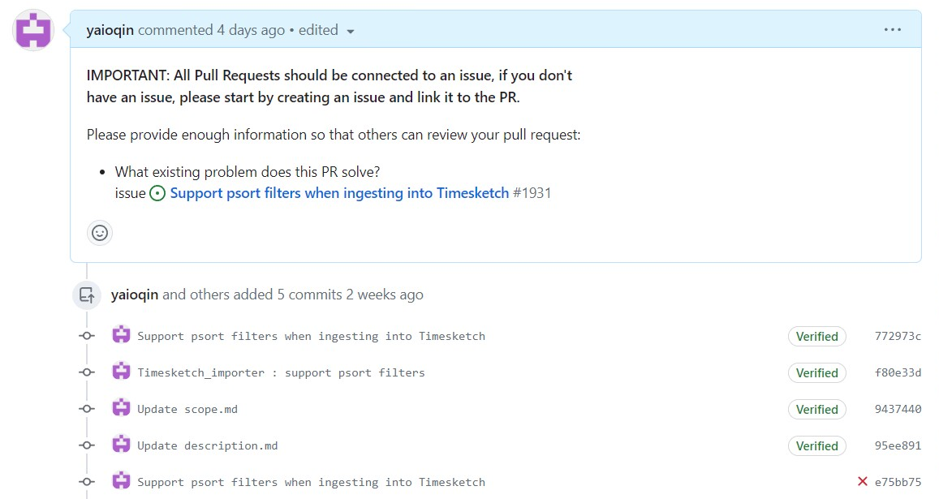
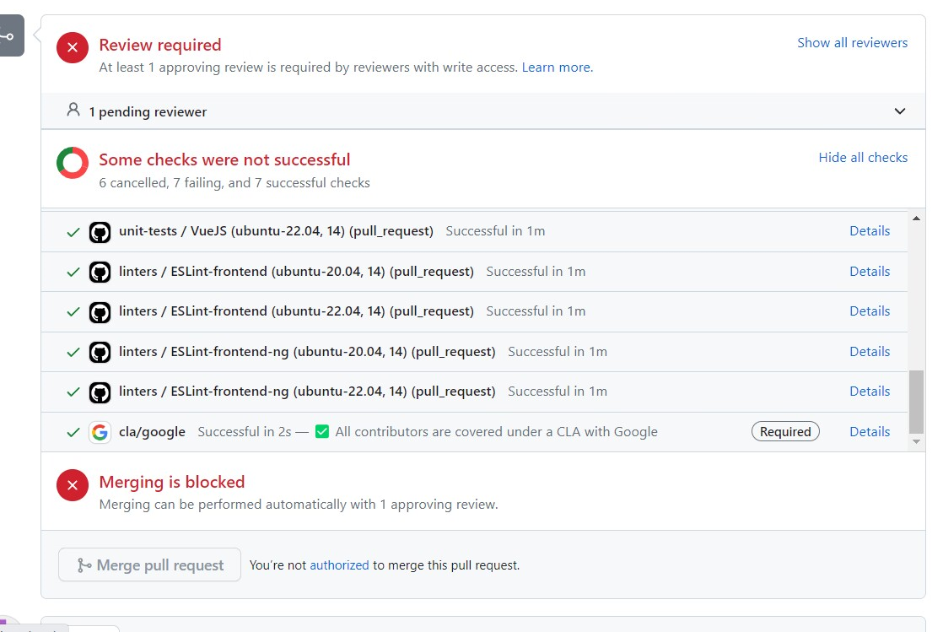
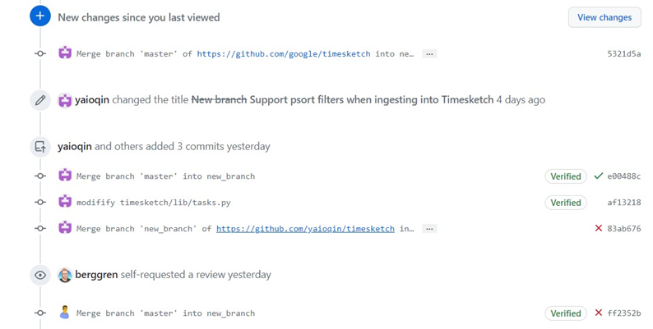
Submit page

Slide 11
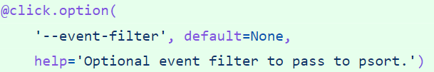
cli_client/python/timesketch_cli_client/commands/importer.py
Define new parameters event-filter
To describe the event filter to be passed to psort, add two parameters to a tuple called args
The event filter must be set before _upload_binary_file() is invoked by add_file().
Redefine function importer

Slide 12
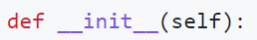
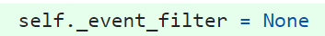
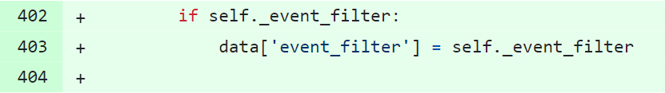
importer_client/python/timesketch_import_client/importer.py
Since the new variable is added, two changes are made to the original function
In the __init__ function, to assign the received arguments to self for use by the whole class, add a new argument
If a newly defined variable appears, data receives the assignment

Slide 13
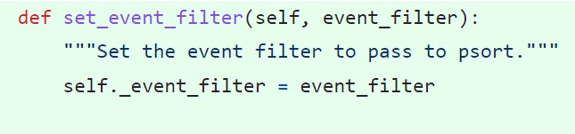
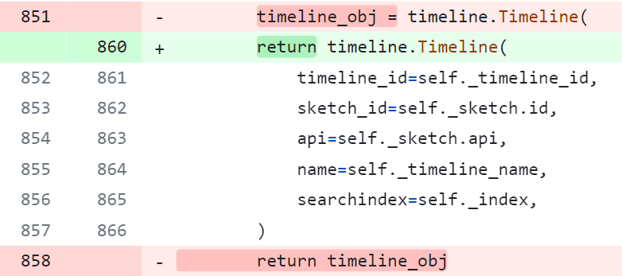
importer_client/python/timesketch_import_client/importer.py
Create a new function: set the event filter to pass to psort.
Returns a timeline object.

Slide 14
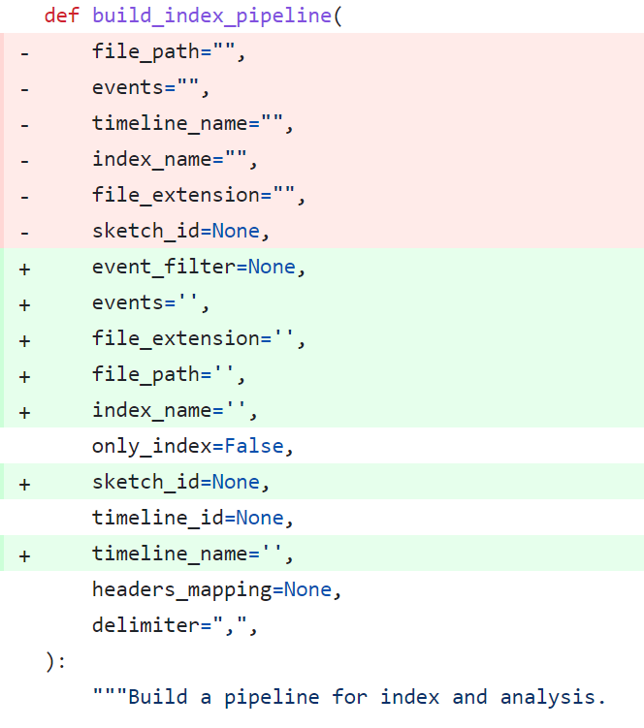
timesketch/api/v1/resources/upload.py
Add a new parameter “event_filter”and reorder the parameters

Slide 15
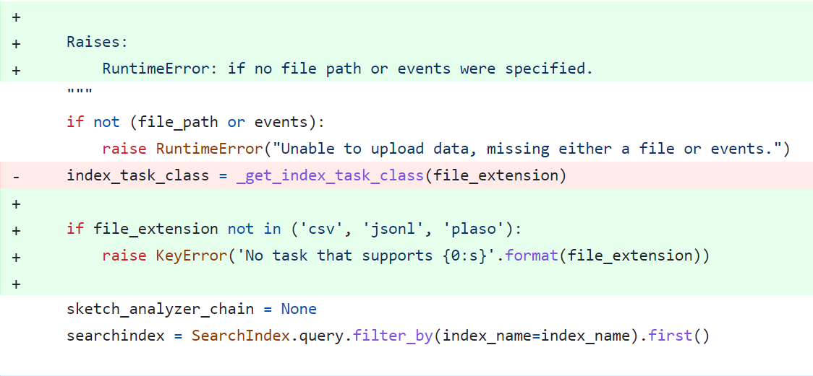
timesketch/api/v1/resources/upload.py
Judgment error :
if no file path or events were specified, it will call RuntimeError
If file_extension is not csv or jsonl or plaso, it will call KeyError

Slide 16
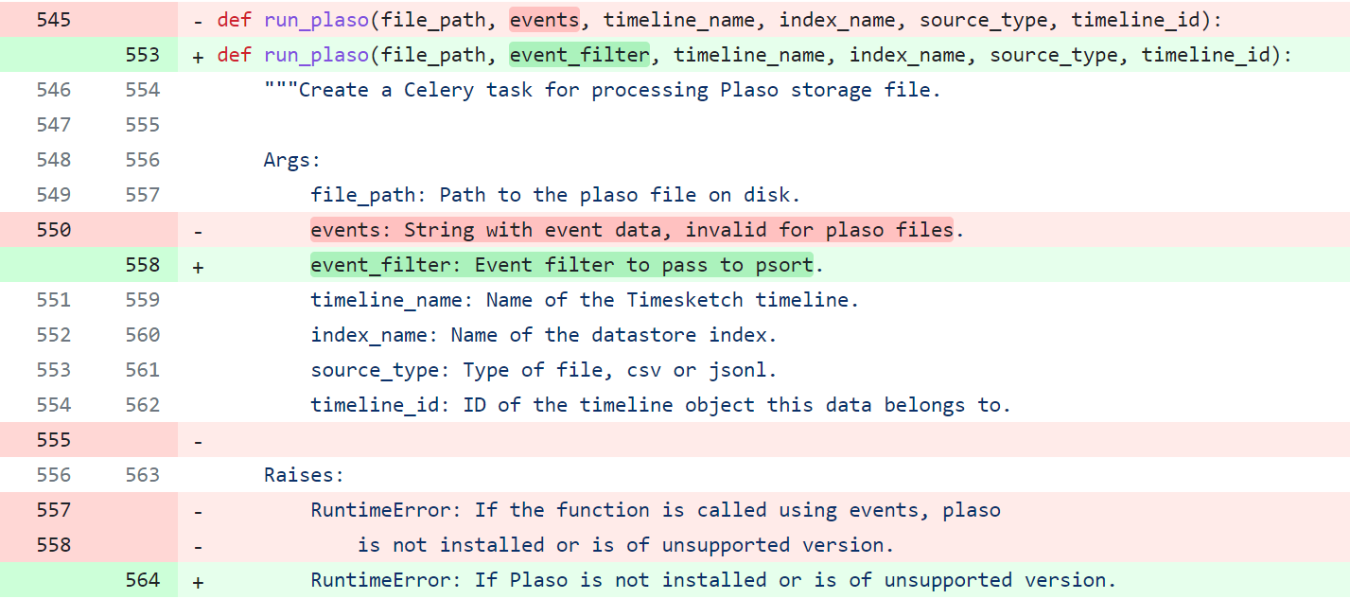
timesketch/api/v1/resources/upload.py
filter events:
Change the parameter 'event' to 'filter'_ Event in order to filter events

Slide 17
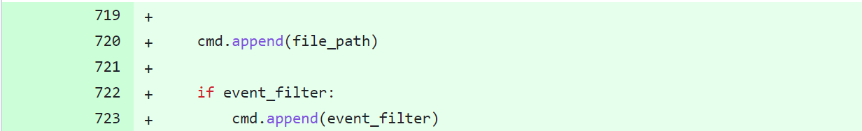
timesketch/api/v1/resources/upload.py
filter events:
Change the parameter ‘event’ to ‘filter_ event’ in order to filter events

Slide 18
03
Lessons we receive from the project

Slide 19
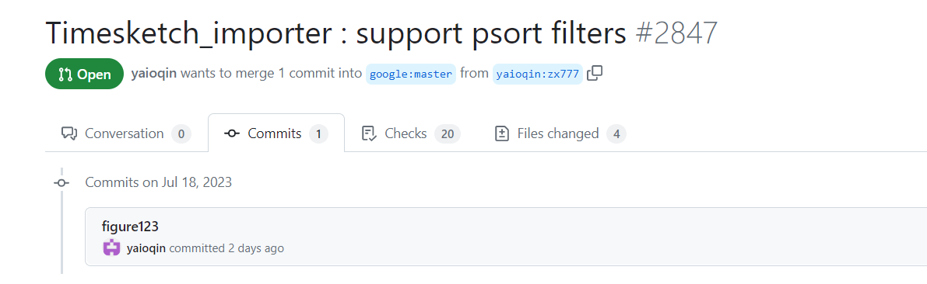
Commit

Slide 20
Lessons
Collaboration: Open-source projects thrive on collaboration. Contributing to such projects teaches teamwork, communication, and the ability to work effectively with diverse groups of people.
Code Quality and Review: Engaging with experienced developers in the community exposes contributors to higher coding standards and thorough code reviews, leading to improved code quality.
Open Communication: Effective open-source contributors learn to communicate openly and transparently, discussing ideas, issues, and solutions openly within the community.

Slide 21
Lessons
Time Management: Balancing open-source contributions with personal/work commitments teaches valuable time management skills.
Dealing with Conflict: Working in a diverse and distributed community may lead to conflicts, and learning to handle them constructively is an important lesson

Slide 22
Look Ahead
It is a pity and we feel sorry that our group hasn't been able to fully solve the issue we chose, but we have gained a lot during the process of contributing to open-source projects.
Though the beginning was not smooth, our team will keep working hard in our future studies, combining the experiences and insights from this journey, and actively participating in the next contribution.

Slide 23
Thanks for your attention!
Team ID: 17
Members: 2021111945 2021112845 2021112810 2021110669
2021112808 2021113278 2021111928 2021111933

